Slide 1

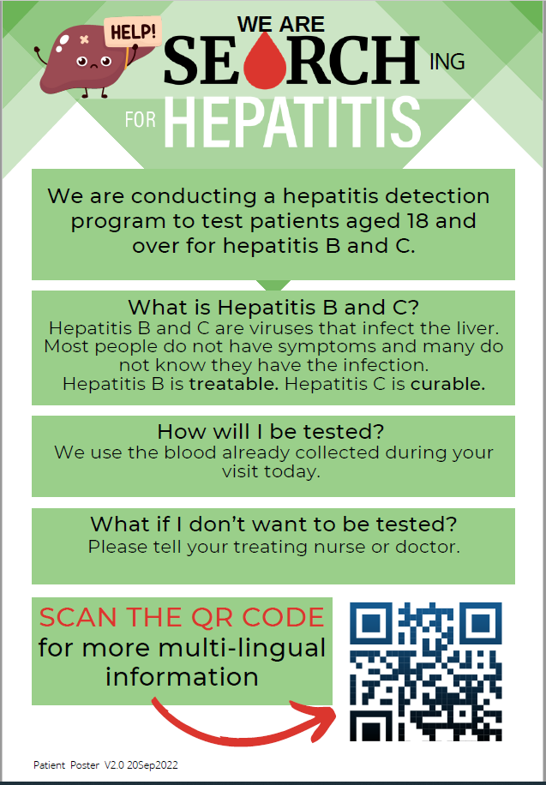


SEARCH 3X
(Screening Emergency Admissions at Risk of Chronic Hepatitis)
3 – EXtension Pilot Program
Dr. David Prince | Julia Di Girolamo | Dr. Basheer Alshiwanna
RESEARCH

Slide 2

Talk Outline
Background Overviews
  Hepatitis C
  Hepatitis B
  WHO Goals
2. SEARCH Study
  Project Structure and Goals
  The Role of ED
  Contacts

Slide 3
Viral Hepatitis
Overview

Slide 4
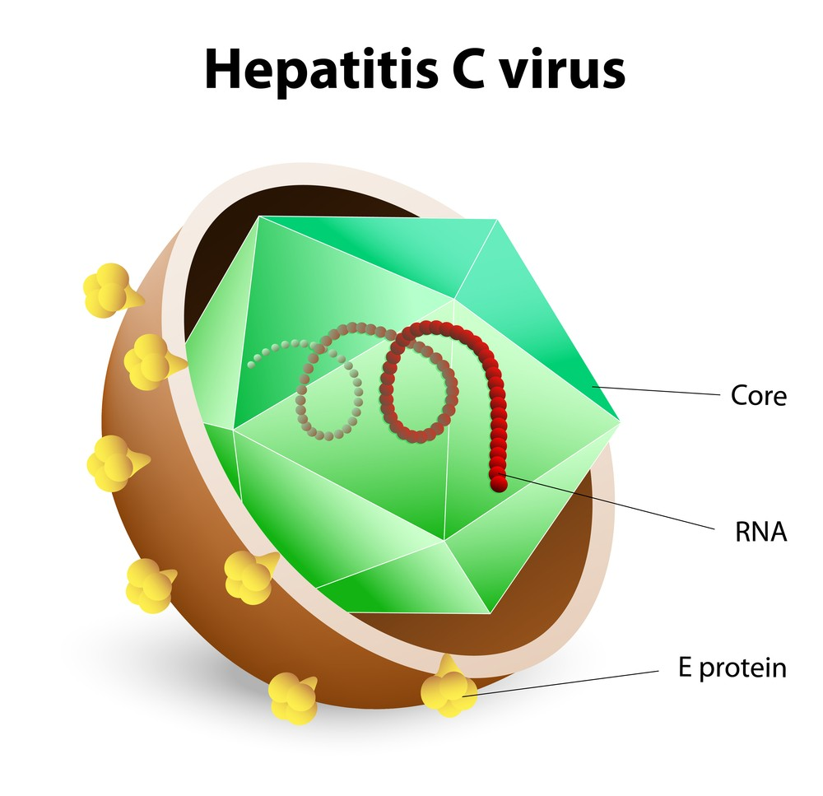
Hepatitis C
RNA Molecule (~3000 AA) – highly diverse
Escape immune response
Unable to develop vaccines
7 Genotypes

Slide 5
Hepatitis C
Transmission | At Risk Groups
Blood borne IVDU Healthcare associated Tattoo / piercing Sexual transmission Perinatal (vertical) – 5% (x2 if HIV) | IVDU Haemodialysis patients Aboriginal & Torres Strait Islander Migrants from high-prevalence Asia, Middle East, Africa, Eastern Europe Incarcerated Sex workers

Slide 6
Hepatitis C
58 million people worldwide. 1.5 million new infections annually

Slide 7
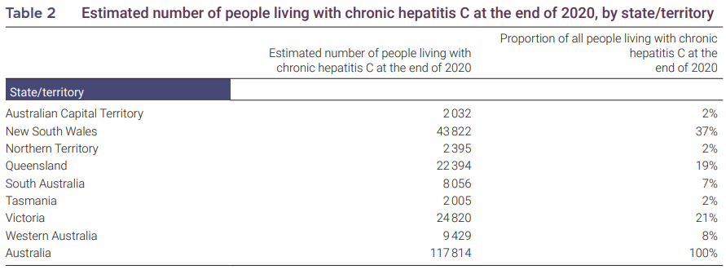
Hepatitis C
Australia – 117,814 people with chronic hepatitis C
Kirby Institute 2021

Slide 8
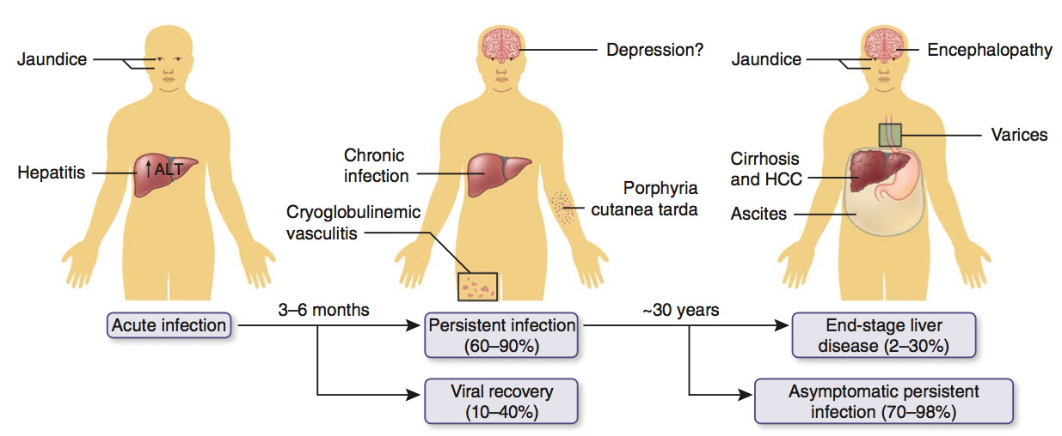
Outcomes of HCV infection
Thomas D. Nat Med. 2013 Jul;19(7):850-8.
Notes:
Figure 1 Outcomes associated with HCV infection. After acute infection, most persons develop viral persistence. Fatigue, joint pain, depression and a variety of skin manifestations can occur but are not usually diagnostic. In otherwise healthy persons infected at young ages, after decades some develop cirrhosis, end-state liver disease or HCC. There are wide ranges of the frequencies of these outcomes owing to differences in host factors such as race, age, HIV infection status and, for progression to end-stage disease, alcohol use.

Slide 9
Hepatitis C Treatment
Direct Acting Antivirals (DAAs) – PBS listed since March 2016
Highly effective all oral therapy
>95% efficacy
Minimal side effects
Safe to prescribe in range of models
As little as 8 weeks duration
Sustained Viral Response (SVR)
- Negative HCV PCR 12 weeks after treatment complete

Slide 10
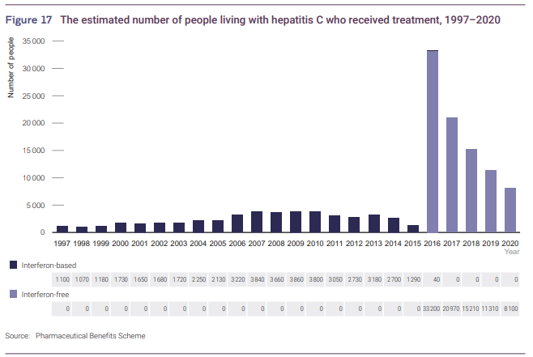
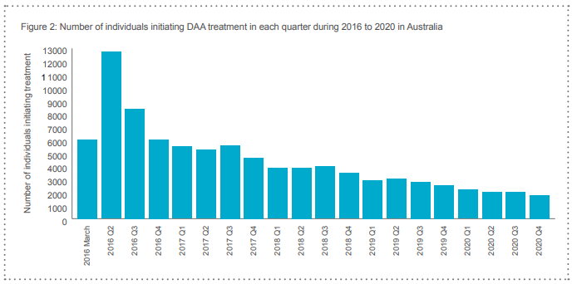
Hepatitis C treatment 1997-2020
Kirby Institute 2021

Slide 11
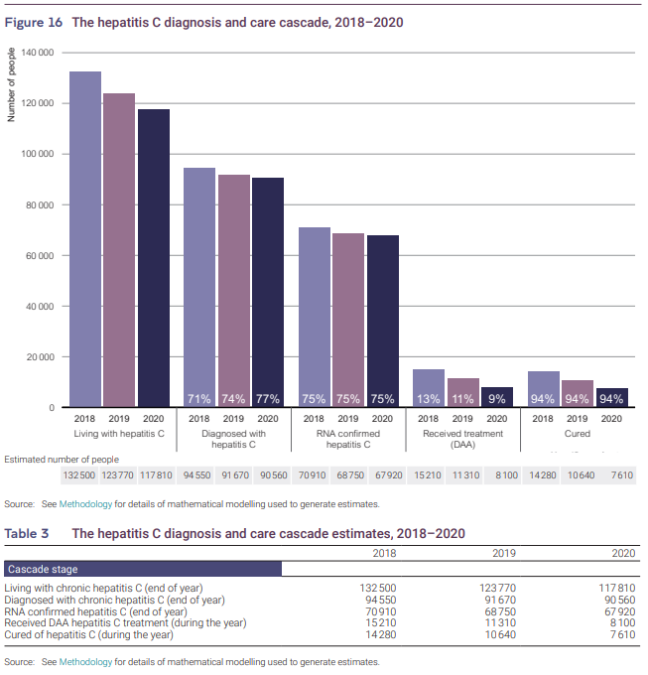
The Current Challenge
Finding people with hepatitis C and enrolling them in care
A significant proportion of infected with hepatitis C remain:
  Unaware of infection
  Not enrolled in care
Kirby Institute 2021

Slide 12
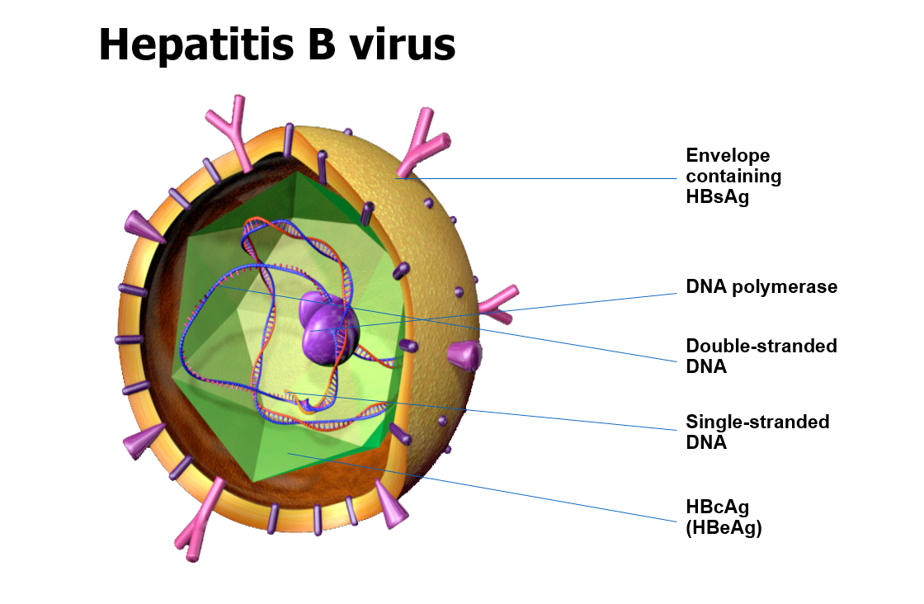

Slide 13
Hepatitis B Transmission
Modes of Transmission
Vertical (Perinatal):
  Especially HbeAg + with high HBV high viral
Horizontal: skin, mucosal breaks, schoolchildren
Sexually acquired
Percutaneous: IVDU, tattoos / piercing, Acupuncture, Household (toothbrush / razors)
Healthcare: blood transfusion, surgical procedures, dialysis, fingerprick
Varies by geographical region
High prevalence regions: Perinatal (vertical)
Intermediate prevalence: Perinatal and Early childhood contact (horizontal)
Low Prevalence: Adult risk groups - parenteral / percutaneous / sexual transmission
Australia: low prevalence but high in migrant and indigenous populations

Slide 14
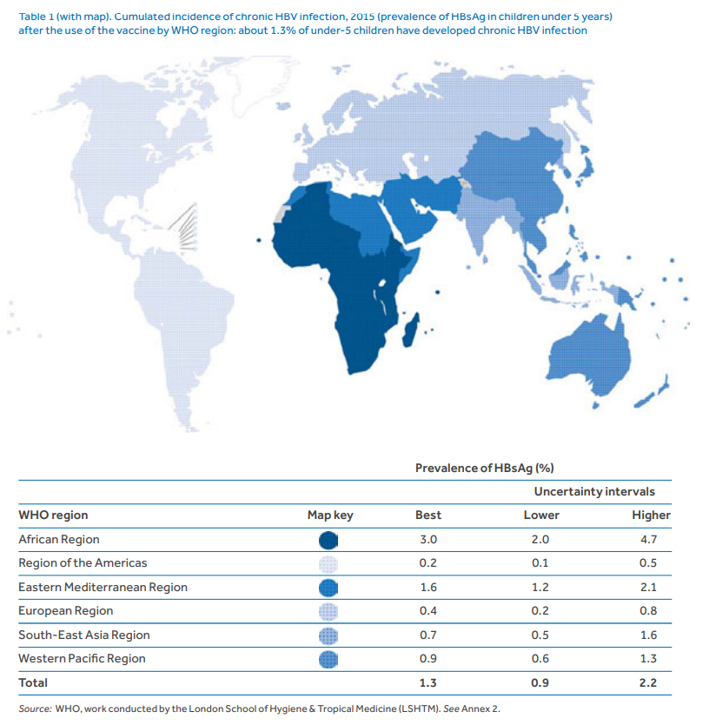
Hepatitis B
Worldwide:
~2 billion infections.
~296million chronic carriers.

Slide 15
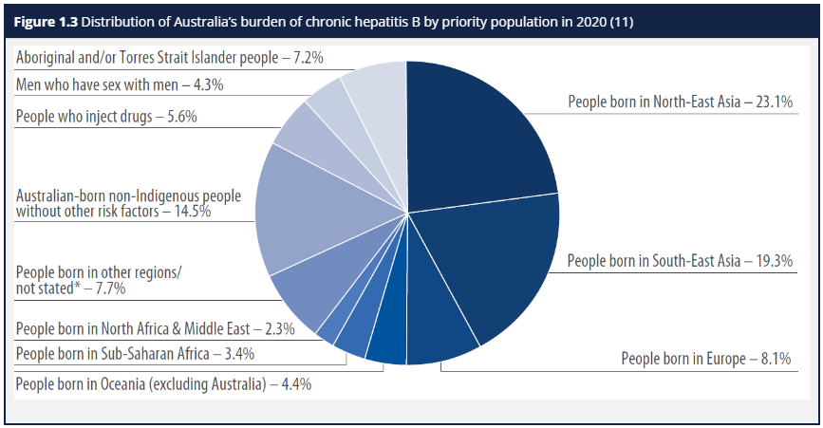
Hepatitis B
Australian Institute of Health and Welfare 2020

Slide 16
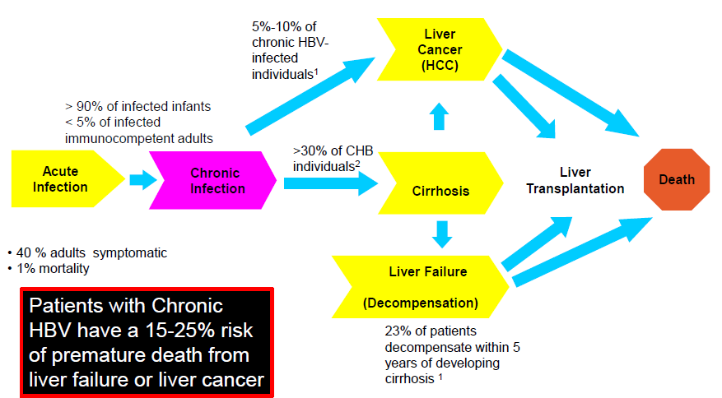
Hepatitis B Infection

Slide 17
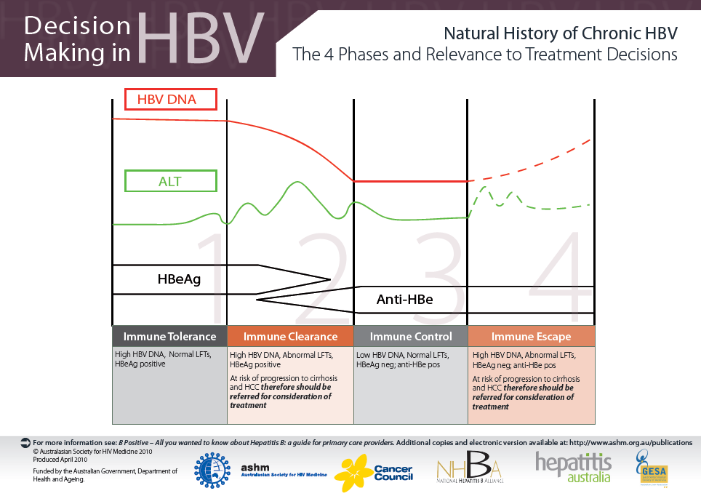
Decision
Making in
HBV
TESTS
HBeAg
Anti-HBe
HBV DNA
ALT

Slide 18
First Line therapy for CHB
ENTECAVIR 0.5mg daily long-term
Or
TENOFOVIR 300mg daily long-term
Or
PEGIFN alfa 48 weeks

Slide 19
HCC surveillance
Surveillance recommended in cirrhosis if risk of HCC >1.5% per year;
in HBV carriers if risk of HCC >0.2%/year
Recommended surveillance is 6 monthly Ultrasound + AFP
Population Group | Incidence of HCC
Asian males with HBV >40 years | 0.4-0.6%/yr
Asian females with HBV >50 years | 0.2-0.6%/yr
HBV infected with FHx HCC | Higher than no FHx
African/Nth American blacks with HBV | Younger age
HBV cirrhosis | 3-8%/yr
HCV cirrhosis | 3-5%/yr
Stage 4 PBC | 3-5%/yr
Genetic haemachromatosis with cirrhosis | Prob >1.5%/yr
A1AT deficiency with cirrhosis | Prob >1.5%/yr
Other cirrhosis | Unknown
Bruix J and Sherman M. AASLD Practice Guideline. Hepatology 2010.

Slide 20
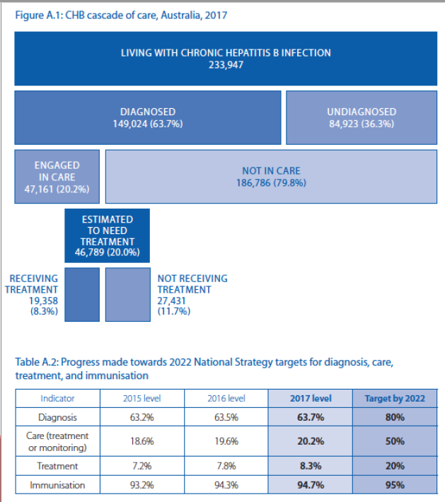
Doherty Institute 2019

Slide 21
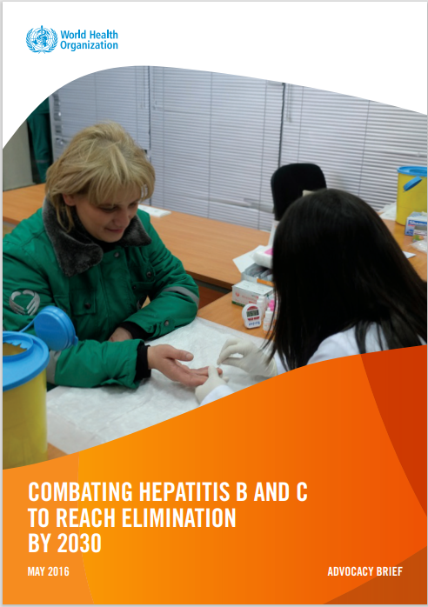
WHO Goals
Combating Hepatitis B and C to reach elimination by 2030
Strategies for prevention and treatment which could reduce chronic Hepatitis B & C
Infections by 90%
Mortality by 65%
Compared to 2015 levels

Slide 22
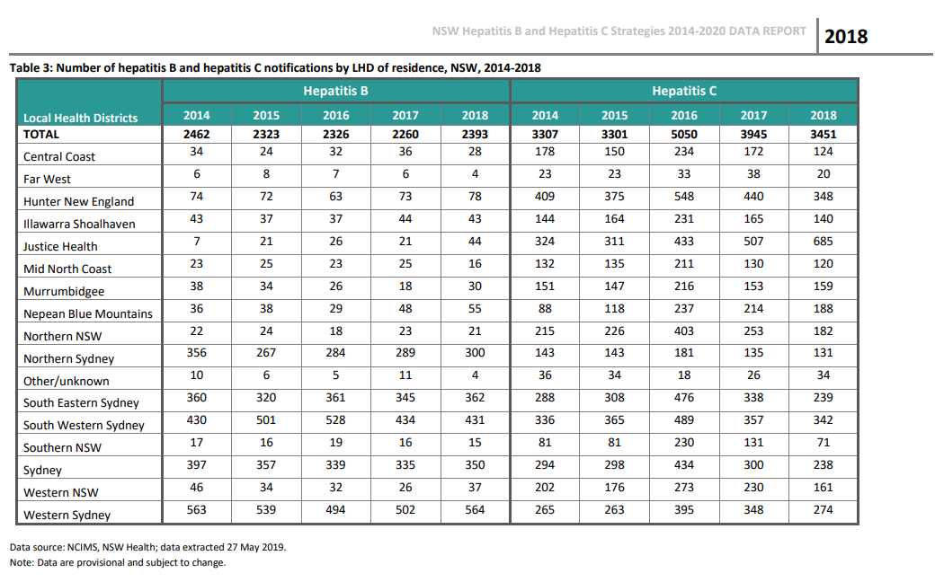
Hepatitis B and C in NSW

Slide 23
Screening
Hepatitis B – Serology (sAg+)
Evaluation
Surveillance
+/- Treatment
Screening
Hepatitis C Ab - Serology
PCR
Hepatitis C RNA - Quantitative
Treatment

Slide 24
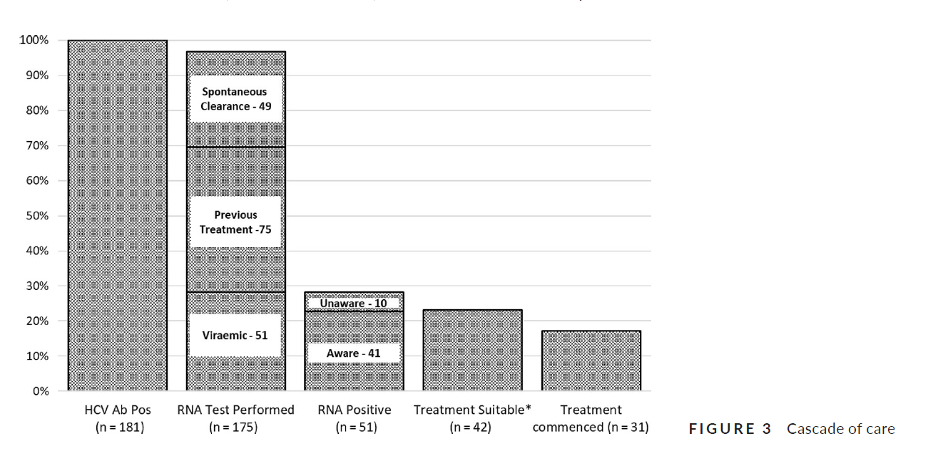
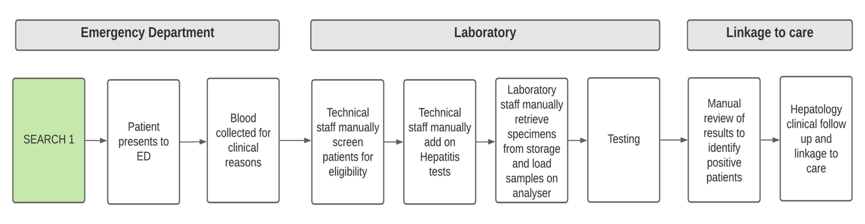
SEARCH 1 - Proof of concept
Single center, Liverpool hospital
HCV
  5000 patients (overseas born or identified as Aboriginal and/or Torres Strait Islander)
  HCV Ab pos 181/5000 (3.6%)
  HCV RNA pos 51/5000 (1.0%)
HBV
  4778 overseas born patients
  HBsAg pos 108/4778 (2.3%)
  20 new diagnosis (19%)
Prince...Levy, Screening Emergency Admissions at Risk of Chronic Hepatitis C (SEARCH) to diagnose or ‘re-diagnose’ infections is effective in Australia, J Viral Hepat, 2020
Jacob…Levy, Routine screening of emergency admissions at risk of chronic hepatitis (SEARCH) identifies and links hepatitis B cases to care, Liver Int, 2022
RESEARCH

Slide 25
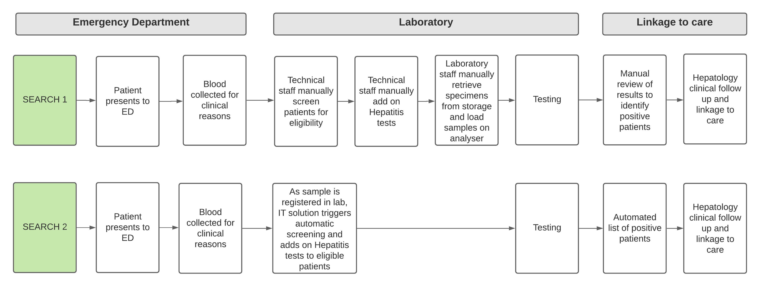

SEARCH 2 - Automation
Single center, Liverpool Hospital
RESEARCH

Slide 26
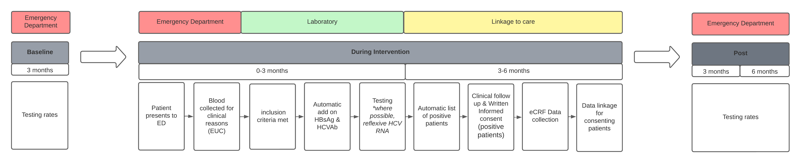
SEARCH 3 Extension (SEARCH3x)
5000 patients per site approximately 3 months

Slide 27
SEARCH 3x Sites
Site | Local Health District | Patient Number | Proposed Launch Date | Run Time (months)
Fairfield Hospital | South Western Sydney | 5000 | Mid- March 2023 | 3
Campbelltown Hospital | South Western Sydney | 5000 | Late June 2023 | 3
Canterbury Hospital | Sydney | 5000 | Late Aug 2023 | 3
Bankstown Hospital | South Western Sydney | 5000 | Late Aug 2023 | 3
Dubbo Hospital | Western NSW | 2000 | Mar 2024 | 3
Liverpool Hospital | South Western Sydney | 5000 | Mar 2024 | 3
RESEARCH

Slide 28
Who is being tested?
Patients who present to the participating emergency department
Age 18 and over
Have a EUC ordered as part of standard of care during the emergency visit
RESEARCH

Slide 29
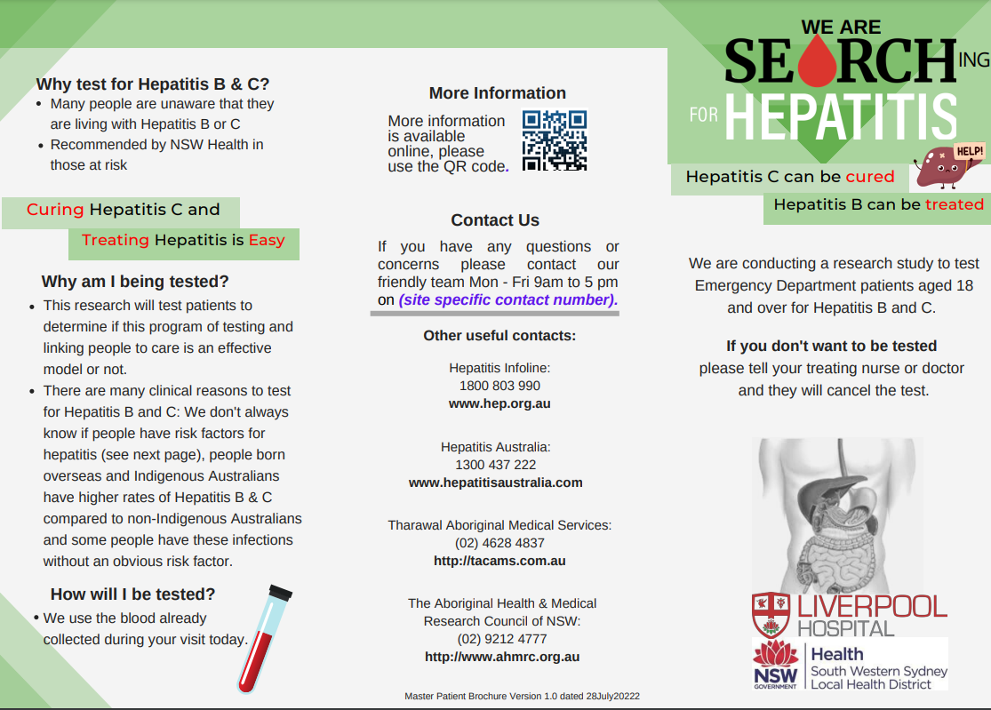
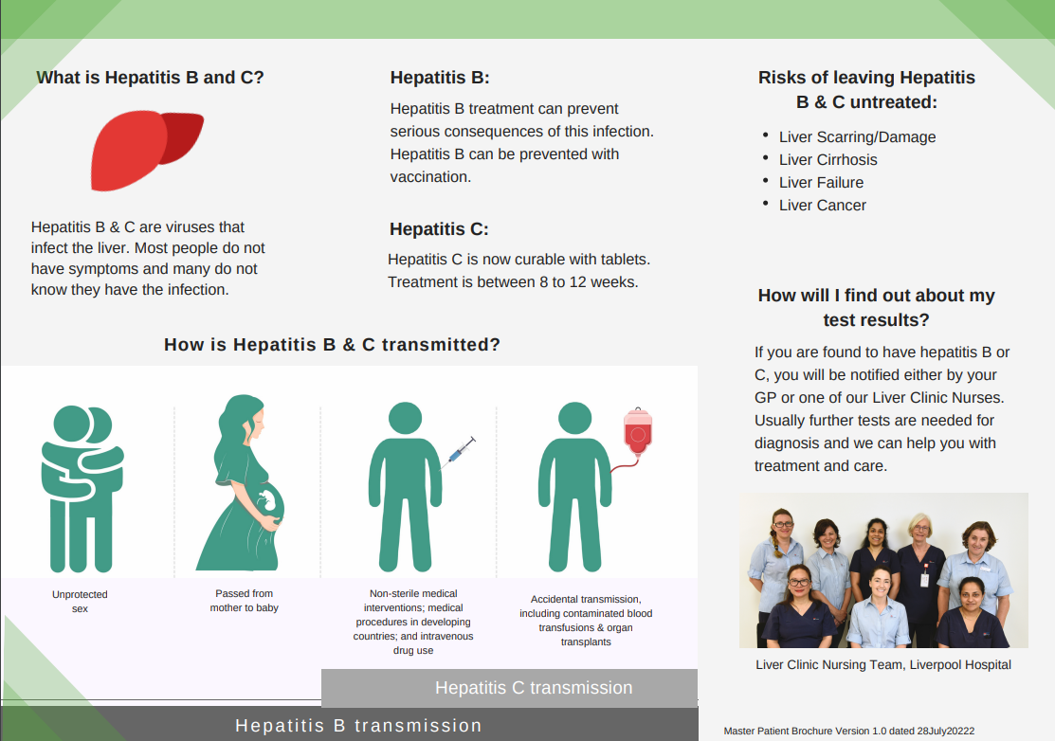
Consent for hepatitis B and C testing
  Posters
    with QR code link to other documents (patient information sheet, brochure)
  Verbal Consent
    Patients will be informed during their ED visit that Hepatitis screening is being performed as part of routine care for all patients at this time
  Patients that Decline
    Do so by telling their ED clinician.
    Fax path form “NO SEARCH” > Fairfield Lab cancels test
    If patients change their mind and decline later – please call us or the lab to cancel the SEARCH test.

Slide 30
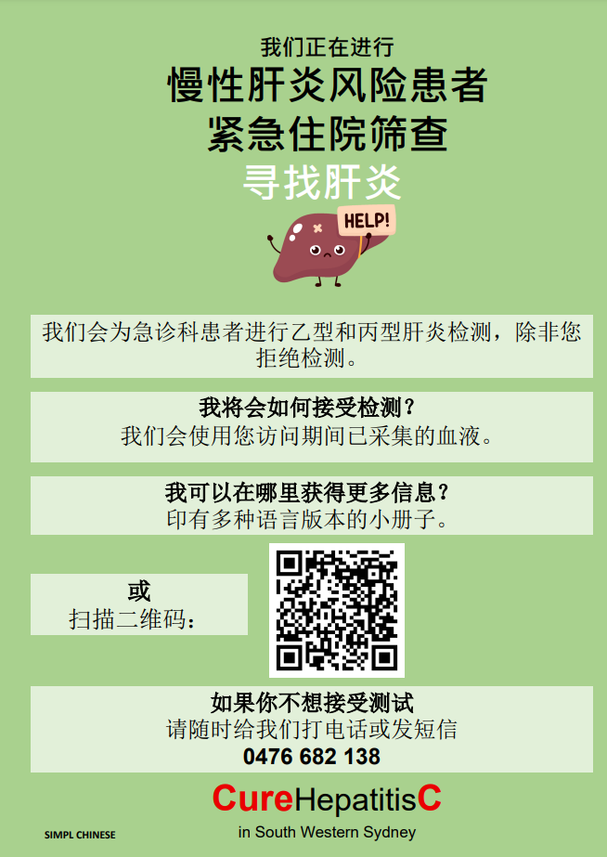
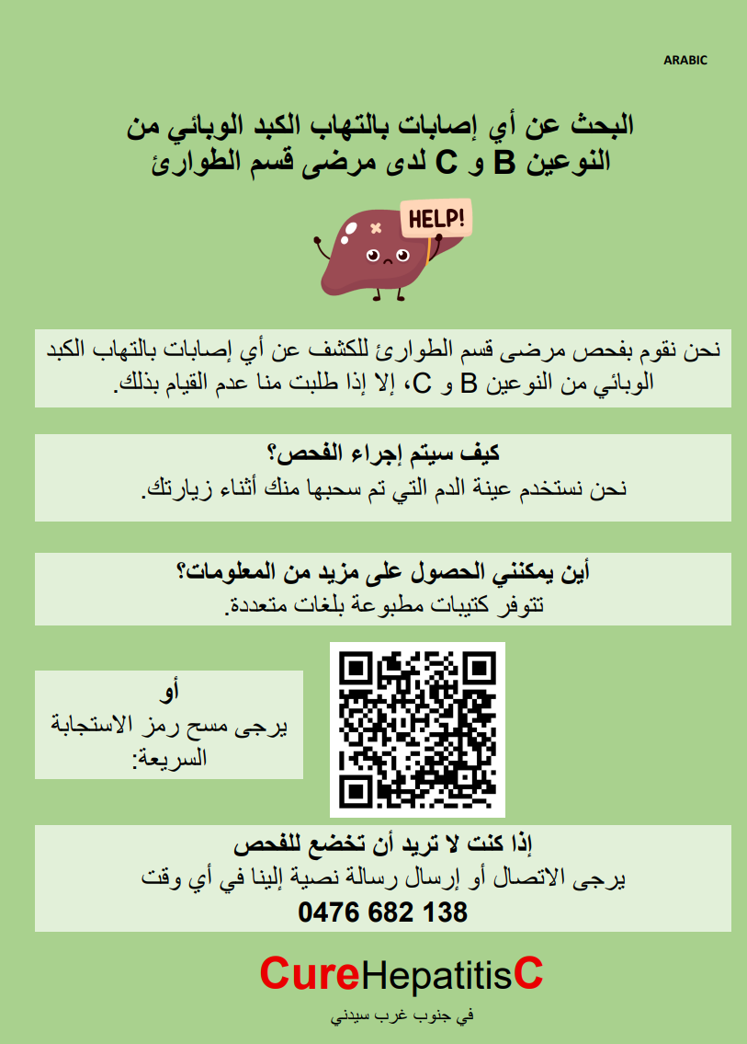
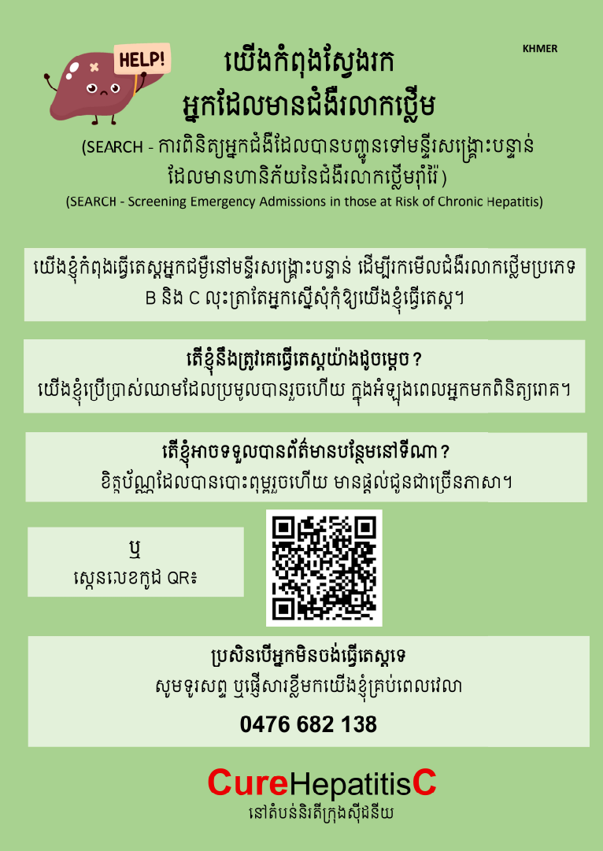
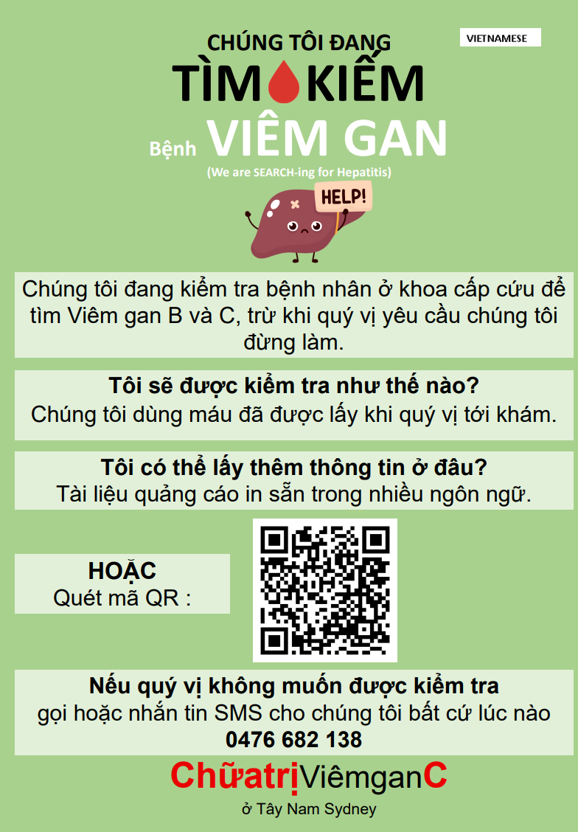
Multi-language patient information materials

Slide 31
Follow up of positive patients
Liverpool SEARCH team will follow up and link patients to care
Hepatitis management as per standard clinical practice
Positive patients will be invited to consent to Research
Observational cohort study to assess outcomes from the project
Data linkage study -Assessment of long term health outcomes via data linkage to national administrative data sets e.g. MBS/PBS
RESEARCH

Slide 32
What does ED staff need to do?
Be aware the Hepatitis testing is occurring
Patients will be informed during ED visit that routine hepatitis testing is occurring for all patients during this time.
If a patient does not want to be tested:
Write “NO SEARCH” on the pathology request form
Remind staff of ongoing screening during meetings and ED huddles
RESEARCH

Slide 33
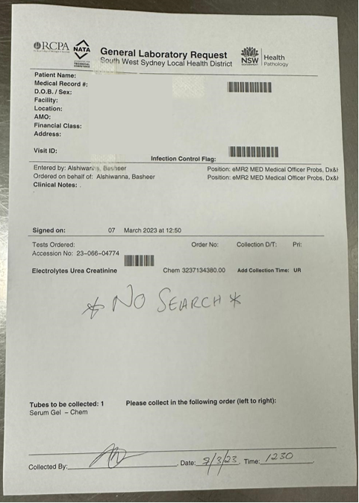
NO SEARCH

Slide 34
Liverpool Contacts
A/Prof Miriam Levy - Chief Principal Investigator
Email: Miriam.Levy@health.nsw.gov.au
Melissa Bagatella – Hepatology Nurse CNC Liverpool
Email: Melissa.Fraser@health.nsw.gov.au
Phone: 02 8738 3571
Dr David Prince - Clinical Operational Lead
Email: David.Prince@health.nsw.gov.au
Julia Di Girolamo - Project Officer
Email: Julia.DiGirolamo@health.nsw.gov.au
Phone: 02 8738 6218
Dr Basheer Alshiwanna – Liver Research Officer
Email: Basheer.Alshiwanna@health.nsw.gov.au
Phone: 02 8738 6216
RESEARCH

Slide 35
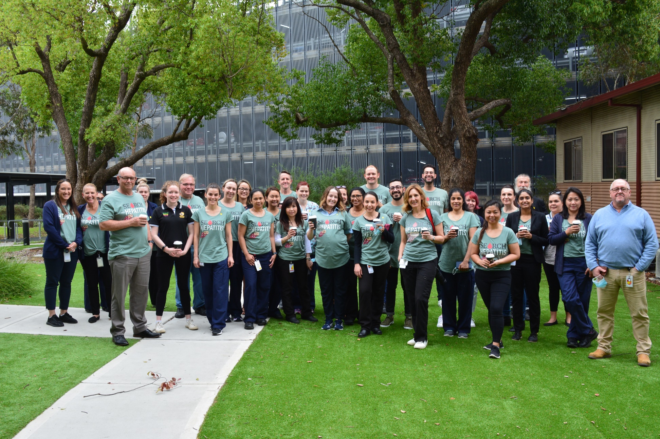
RESEARCH

